Slide 1

Final Year Project Presentation
By
SAYAK HALDAR
SOURAV DAS
SOUMYADEEP SAMANTA
PRITAM KUMAR RAY

Slide 2

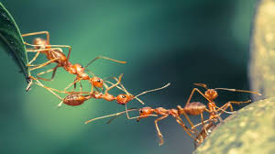

INTELLIGENT PUZZLE SOLUTION PROCESS USING SWARM INTELLIGENCE

Slide 3
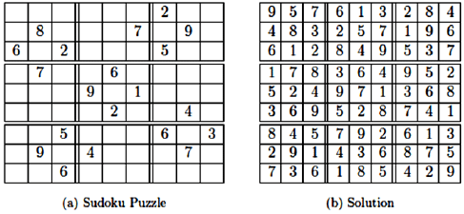
Introduction
What is Sudoku Puzzle?
Backtracking ,the traditional way to solve Sudoku.
Motivation of our concept

Slide 4
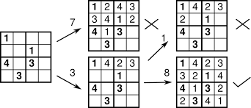
Backtracking Method to Solve Sudoku
Try for all Possible Solution
Choose the Best one
Time Complexity
Problems with Backtracking

Slide 5

Swarm Intelligence
What is Swarm Intelligence?
How does Swarm Intelligence work?
Various examples of
Swarm Intelligence

Slide 6
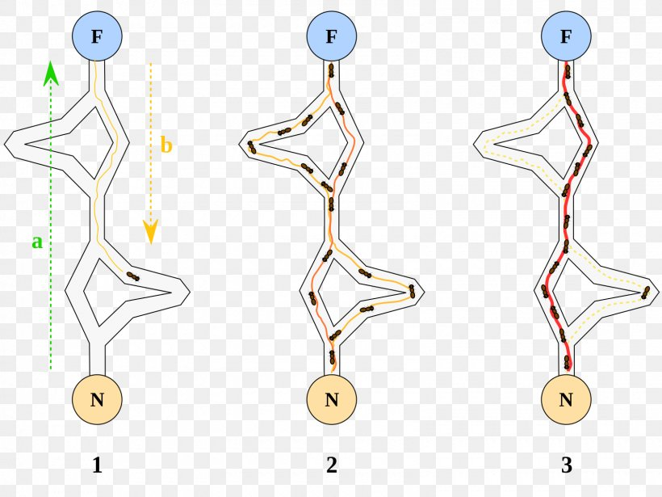
Ant Colony Optimization Method
Use of Pheromone to find out
the Shortest Path
Use to find Optimal solution of a Sudoku
Use of ACO algorithm to find the solution.

Slide 7
Problem Formulation and Concept Building
Solving Sudoku using Fundamental Rules of Sudoku
Improvement over Backtracking by using Ant Colony Optimisation method
Performance evaluation and comparison for both ATM and Backtracking

Slide 8
Performance Evaluation Parameters
Time required to produce the Output
Number of changes done in a particular
Blank Cell
Difference of Time Complexity in case of Easy, Medium and Hard level Sudokus

Slide 9
Proposed Work
What is ATM?
Main aspects
Objective behind ATM

Slide 10
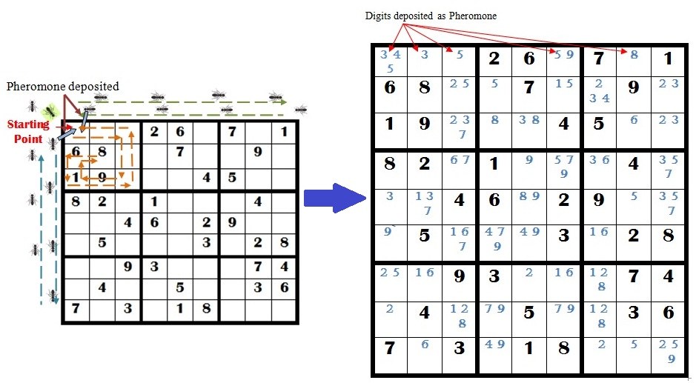
How ATM works?

Slide 11
Advantages of ATM
In depth Feasibility study performed by Ant(agent)
Reduction of wastage of effort
Minimum number of changes

Slide 12
Data Structures Used
ph[9][9][9] - 3-D array, used for storing the 9 types of pheromone representing digits from 1 to 9 for all cells of a Sudoku;
p - It is a variable, it stores the pheromone found in the corresponding cell of the Sudoku matrix;
n - Dimension of Sudoku matrix
m[n][n] - 2-D array, used to represent a (nXn) Sudoku matrix

Slide 13
Algorithm
Input:
Total Pheromone of Ant Agent
Pheromone found in a cell
Step 1: Start
Step 2:For(a particular empty cell let m[i][j]){
1.Traverse Row-wise(i:=1 to n), Column-wise(j:=1 to n) and SubMatrix-wise(3*3).
2.if(Sudoku matrix element k exist on traversal path ) then
ph[i][j][k]:= DELETED

Slide 14
Algorithm(contd.)
3. if(single pheromone exist for a empty cell) then
Set the number to the cell
Goto Step 1
else
Move to the next empty cell and goto Step 2

Slide 15
Algorithm(contd.)
Step 3: for i , j , k:=1 to n
Display ph[i][j][k].
Step 4: Exit.
Output:
Pheromone available in the Ant Agent after traversing the allotted path

Slide 16
EXPERIMENTS AND ANALYSIS
Two types of sudoku problems based on the hardness are considered. The results are summarized and compared in the following table.
|V| | Hardness | ATM |  | Backtracking
 |  | T | Time | T | Time
28 | Medium | 504 | 0.008 | 1482 | 0.008
29 |  | 1939 | 0.008 | 1939 | 0.008
29 |  | 1985 | 0.012 | 1985 | 0.008
29 |  | 583 | 0.006 | 796 | 0.007
30 |  | 0 | 0.006 | 713 | 0.007
22 | Hard | 137212 | 0.085 | 138156 | 0.085
 |  | 1202 | 0.004 | 3207 | 0.010
23 |  | 1202 | 0.004 | 3207 | 0.010
 |  | 575 | 0.007 | 79609 | 0.061
24 |  | 575 | 0.007 | 79609 | 0.061
 |  | 529 | 0.008 | 882 | 0.008
25 |  | 529 | 0.008 | 882 | 0.008
 |  | 11603 | 0.015 | 13418 | 0.016
26 |  | 11603 | 0.015 | 13418 | 0.016

Slide 17
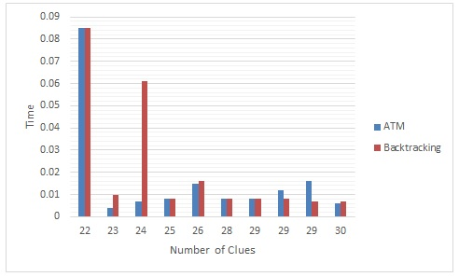
Experiment and Analysis(Contd.)
Comparative analysis of execution time between ATM and Backtracking method

Slide 18
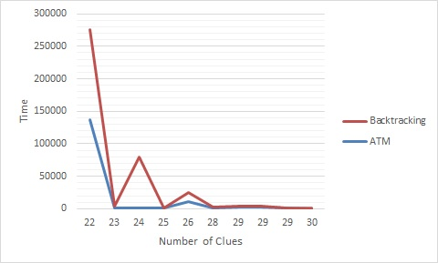
Experiment and Analysis(Contd.)
Comparison of number of times value of a cell is changed

Slide 19
CONCLUSION
Less Time Consumption
Number of failed attempts to insert a digit is Less
Out-performs existing algorithms
Beneficiary for solving different computational problems

Slide 20


